Slide 1


Slide 2
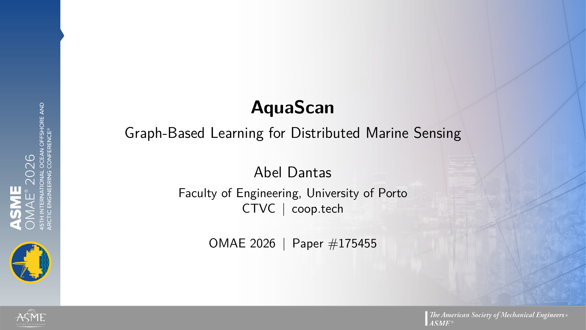
Notes:
Good morning. My name is Abel Dantas, from the Faculty of Engineering at the University of Porto - Portugal, and CTVC (coop.tech).

Slide 3
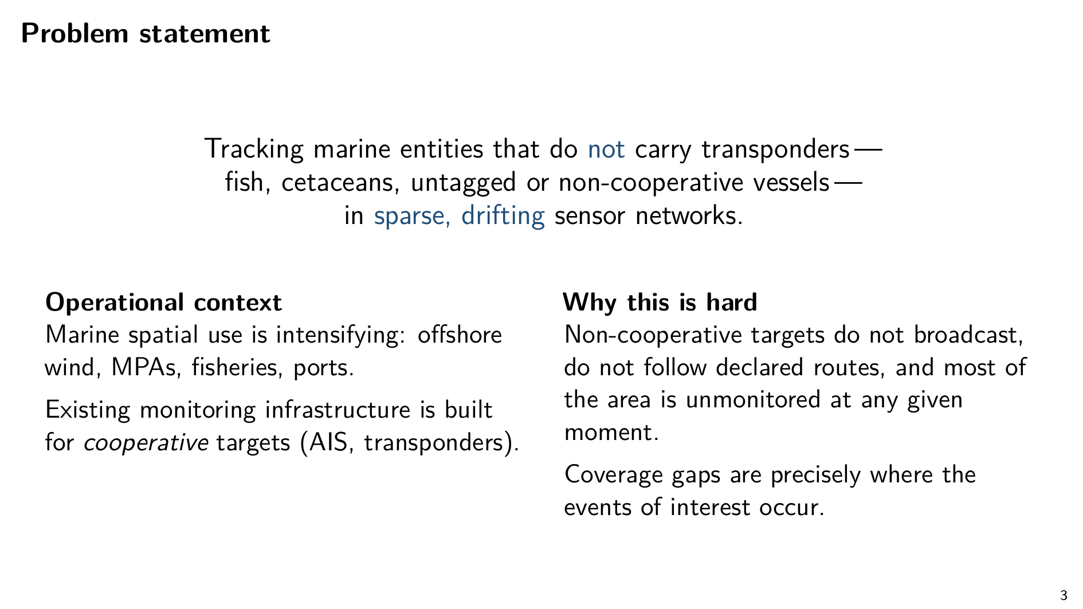
Notes:
The work I'm presenting asks the question of: when we want to track things in the ocean that don't carry transponders — schools of fish, whales, untagged or non-cooperative vessels — can we do better by treating the sensor network as a whole, instead of tracking each thing on its own?
Because, Existing infrastructure was built for cooperative targets. Marine wildlife and dark vessels do the opposite: they don't broadcast, they don't follow predictable routes, and the coverage gaps are exactly where the events of interest occur.

Slide 4
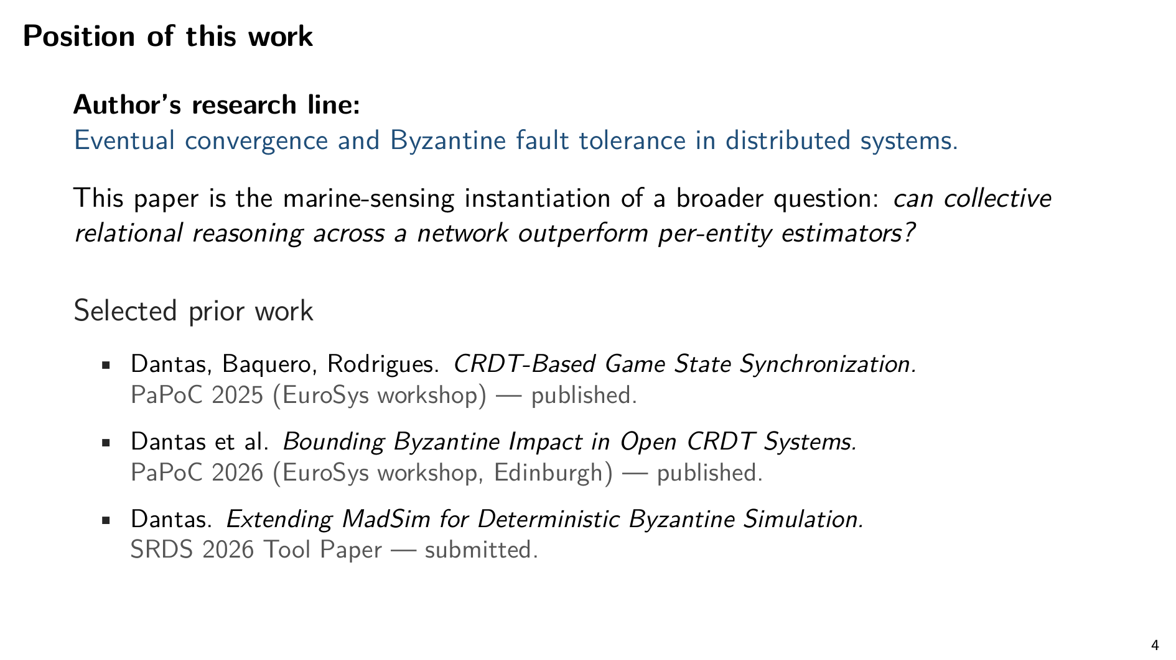
Notes:
To give some context about myself and my research, myresearch line is on eventual convergence and Byzantine fault tolerance in distributed systems.
And here are some of my recent publications, CRDT synchronization paper, the bounded-impact CRDT paper, and more recently I've been working on another simulation tool on top of MadSim that extends it to Byzantine participants - that one is pre-print - under review at SRDS 2026. I'll come back to the BFT thread at the very end.

Slide 5
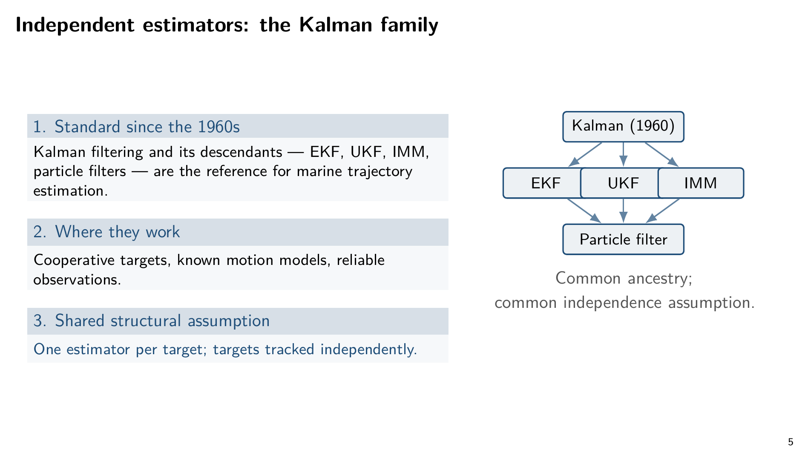
Notes:
The dominant tool for marine trajectory estimation, going back to the 1960s, has been the Kalman filter and the estimators built on top of it: Extended, Unscented, Interacting Multiple Model, particle filters. They perform well for cooperative targets with known motion models and reliable observations.
Every variant in the family shares one structural assumption: one estimator per target, targets tracked independently.

Slide 6
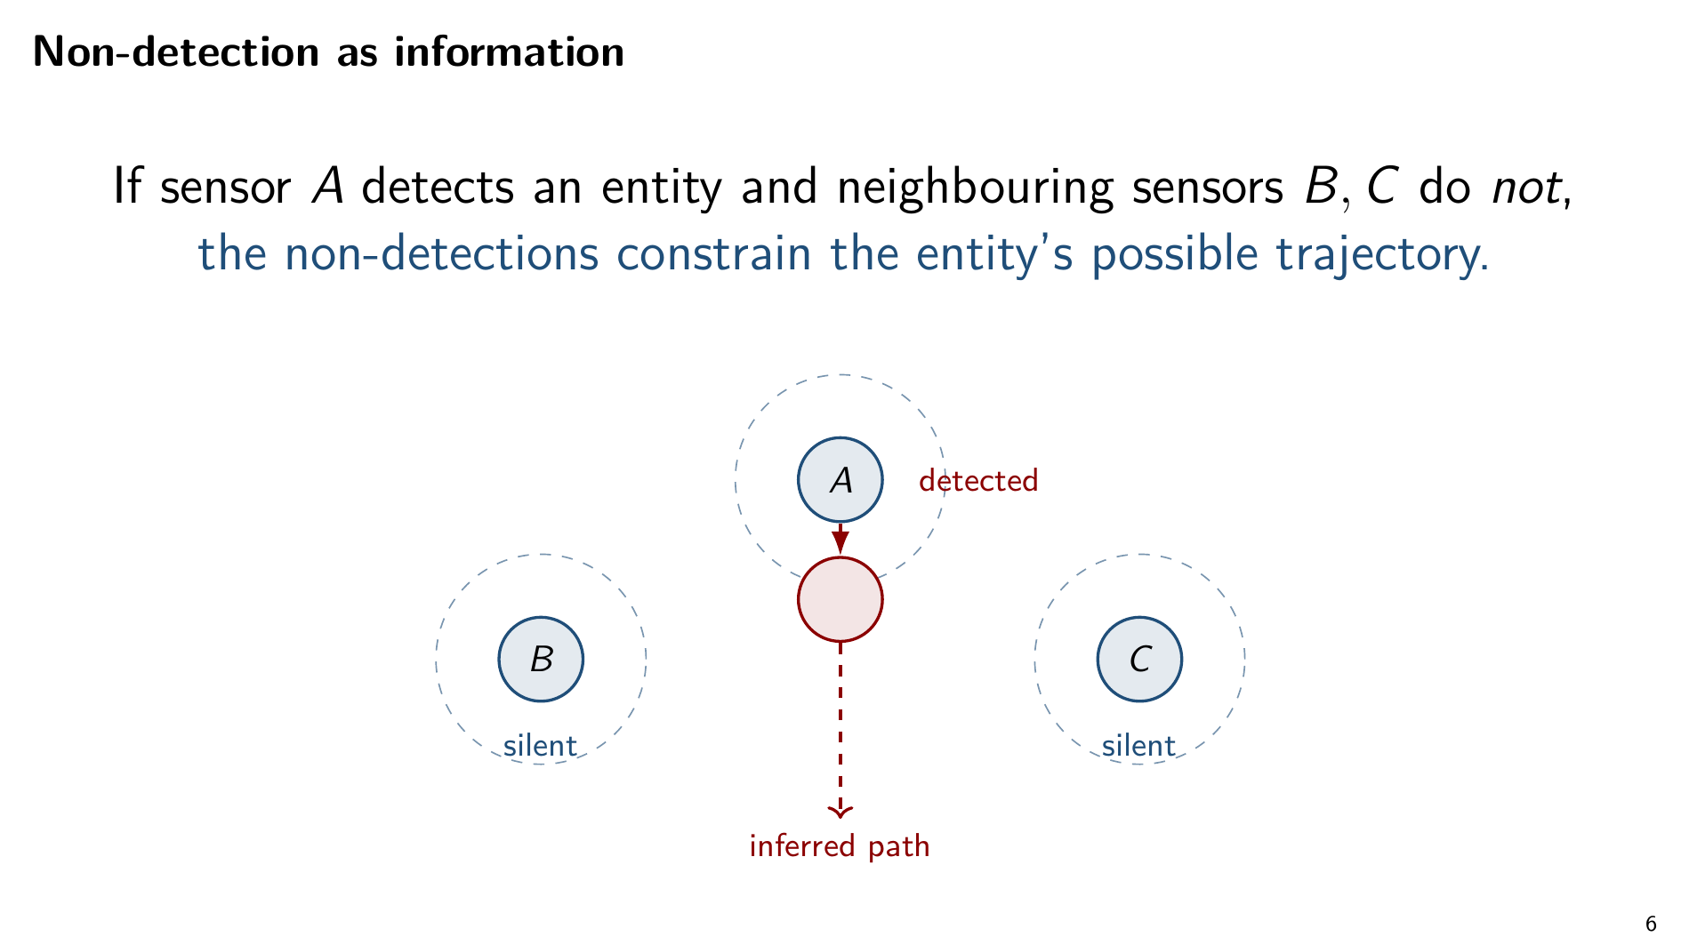
Notes:
And this is the line I want you to take from this part of the talk:
A non-detection is information. If sensors B and C did not observe a school of fish in the last minute, that constrains where the fish could be. A traditional tracker cannot consume that signal. A model defined over the sensor graph can.

Slide 7
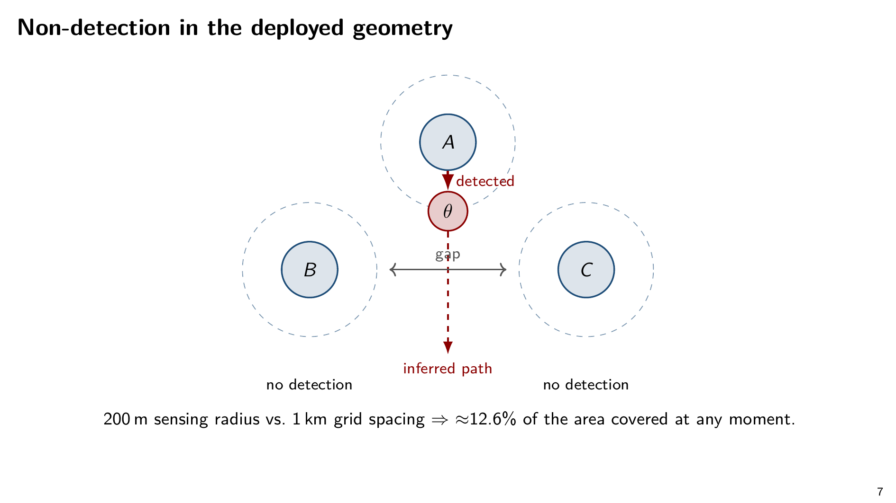
Notes:
Concretely, in the geometry we deploy at: with a 200 metre sensing radius and a 1 kilometre grid, only about 12.6% of the area is under direct coverage at any moment.
When A detects an entity and B and C don't, the entity is constrained to be somewhere in that gap. The inferred path goes downward through the uncovered region. This is the picture in your head for the rest of the talk.

Slide 8
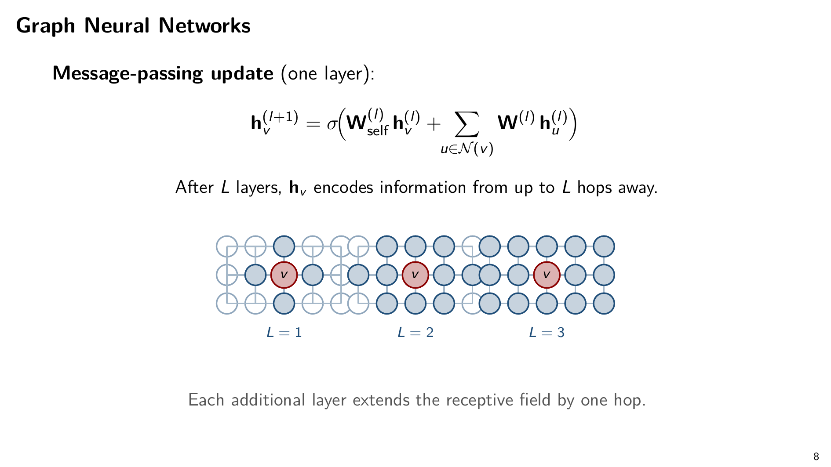
Notes:
Quick orientation on Graph Neural Networks, in case they're new to you.
A GNN is a parametric model that operates directly on a graph. Each node starts with a feature vector. At every layer, each node updates its state by aggregating its neighbours' states. After L layers, a node's representation reflects itself, its neighbours, and so on out to L hops. The receptive field grows one hop per layer.
In our setting we use three layers. That's the mechanism that lets the network reason about who observed what, who didn't, and what's likely to happen next.

Slide 9
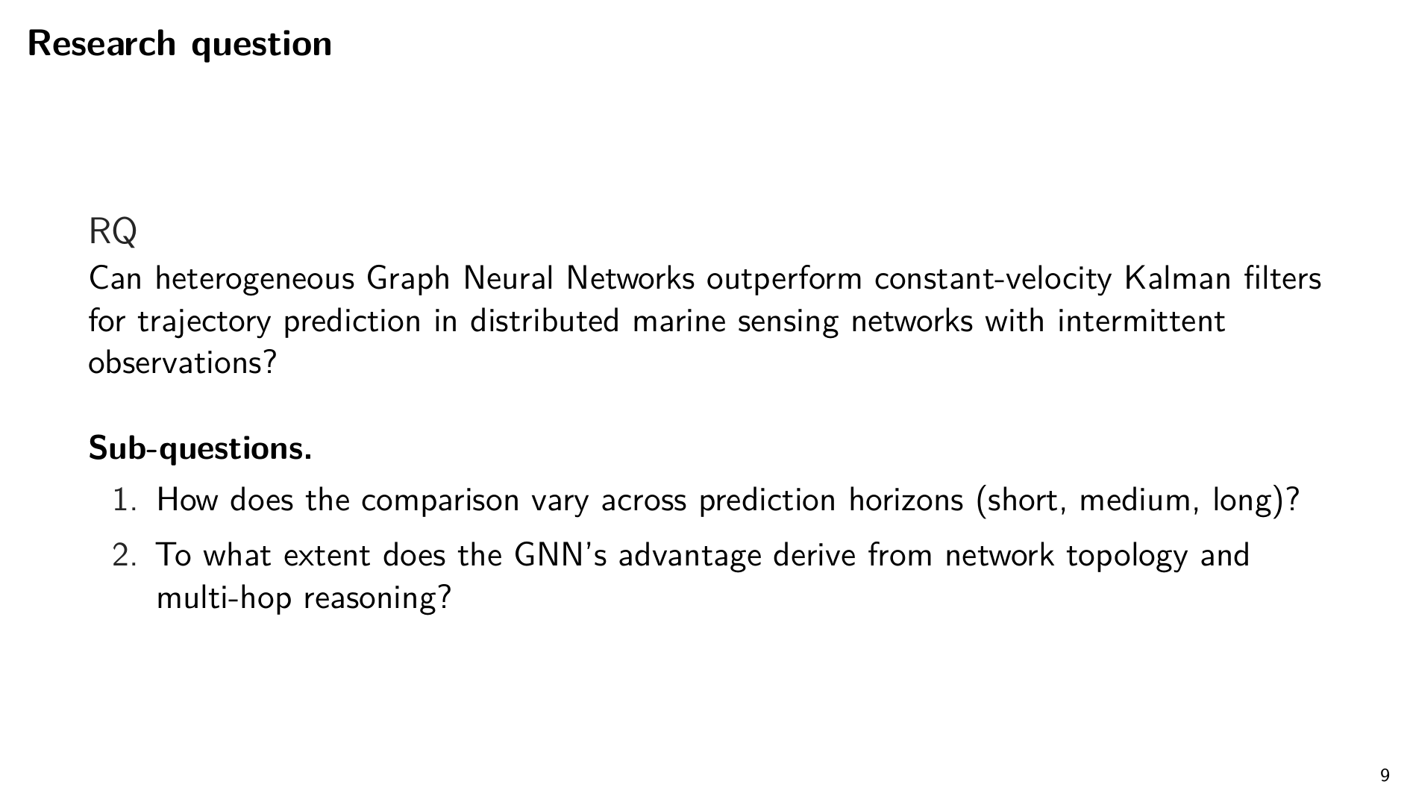
Notes:
So the question is precisely this: can heterogeneous Graph Neural Networks outperform constant-velocity Kalman filters for trajectory prediction in distributed marine sensing networks with intermittent observations?
Two sub-questions. How does the comparison hold across short, medium, and long horizons? And how much of the GNN's advantage comes from leveraging network topology and multi-hop reasoning?

Slide 10
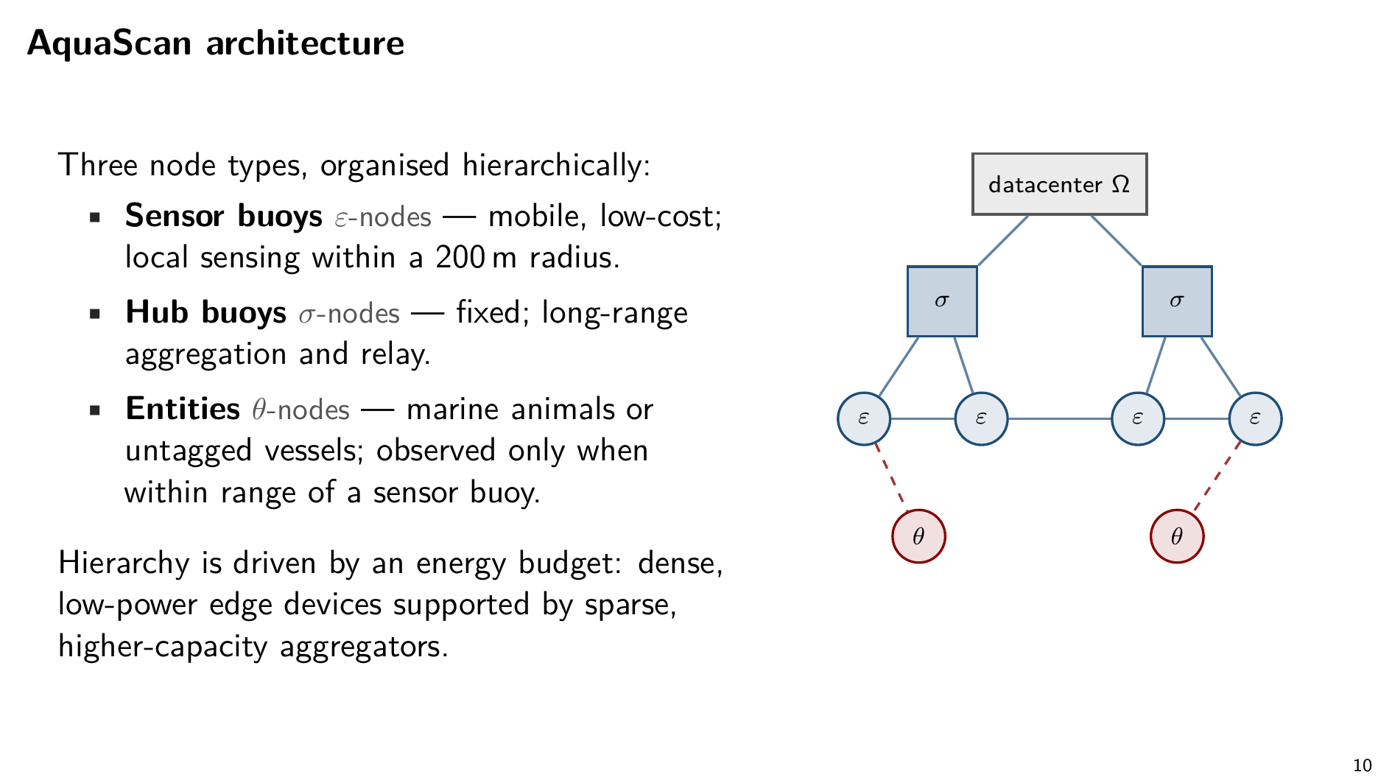
Notes:
To answer those questions we built AquaScan. Three node types, organised in a hierarchy. I'll use plain names; the paper uses Greek letters in parallel.
Sensor buoys: small, mobile, low-cost. Local sensing in a 200 metre radius. You deploy a lot of them.
Hub buoys: larger, fixed, communication hubs. They carry the long-range hardware the smaller buoys can't afford.
Entities: marine animals or untagged vessels. Not instrumented. Observed only when within range of a sensor buoy.
The hierarchy is driven by an energy budget — dense, low-power edge devices supported by sparse, higher-capacity aggregators.

Slide 11
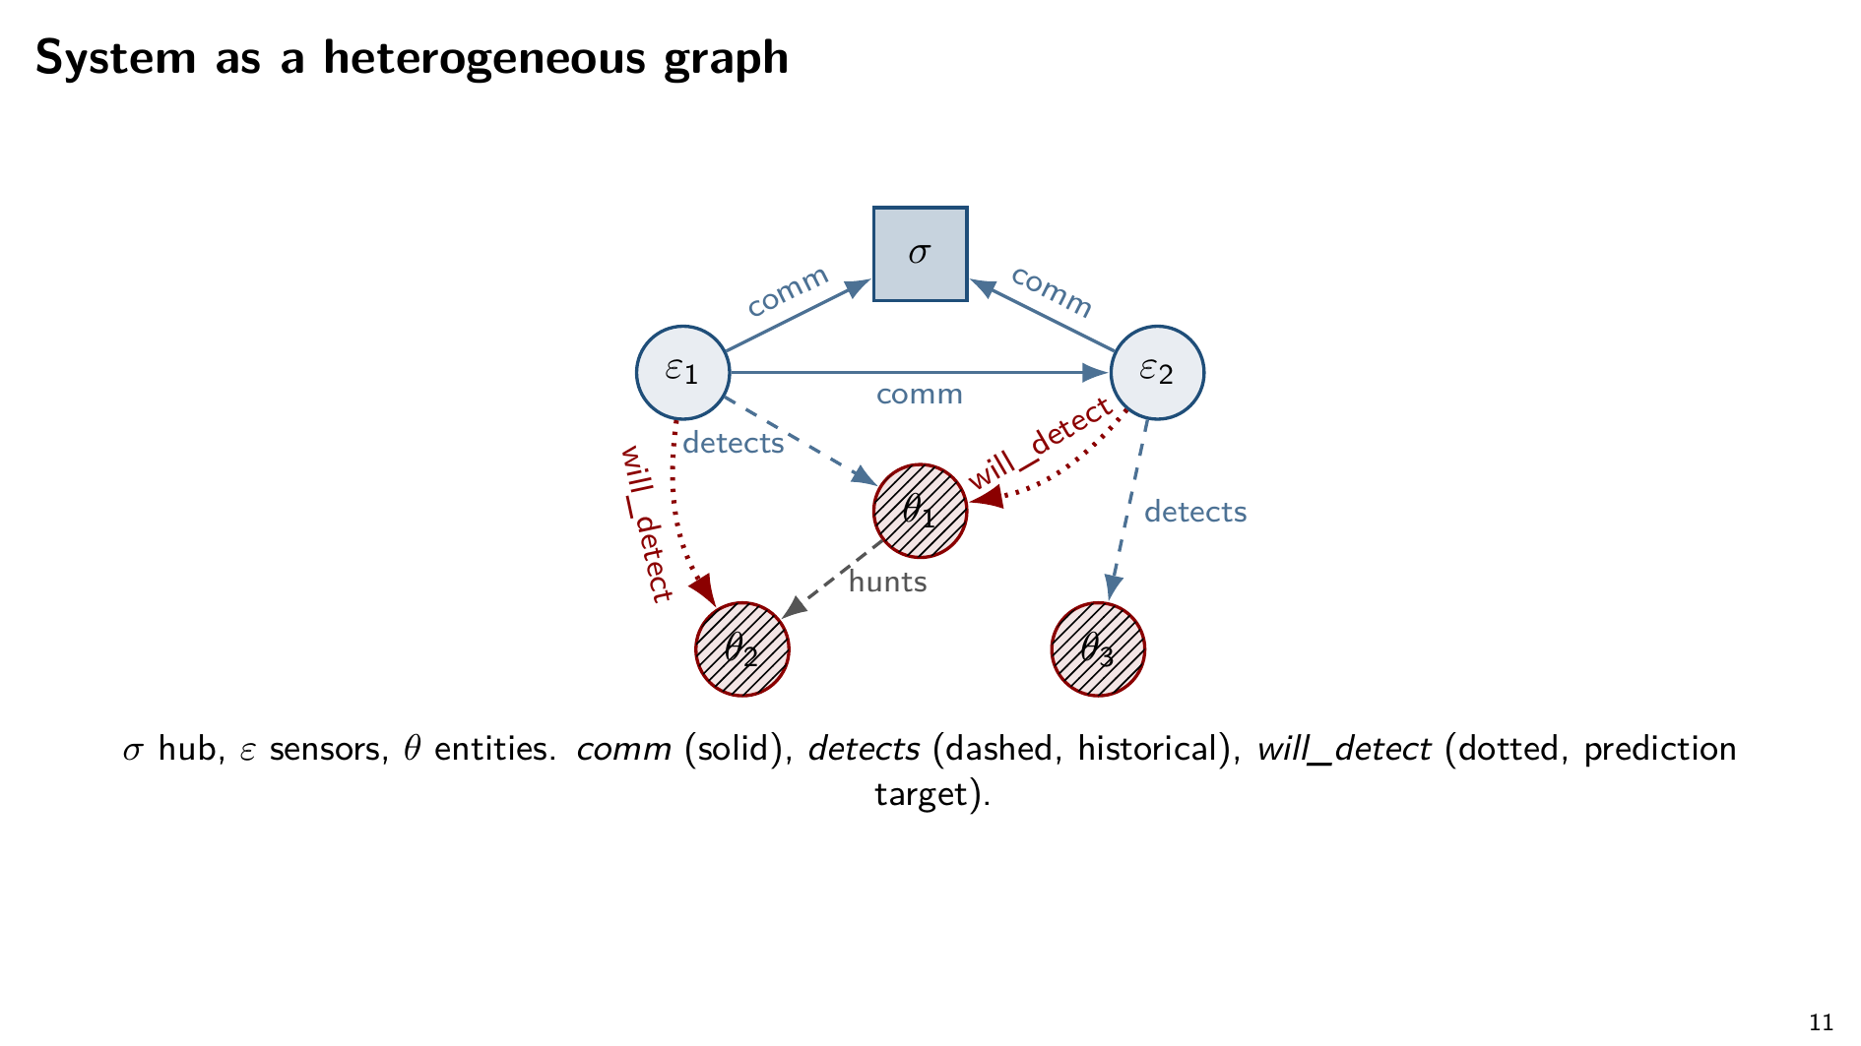
Notes:
Same nodes, now as the heterogeneous graph the model actually operates on.
Three edge types. comm — sensor to sensor. detects — sensor to entity, historical. will_detect — sensor to entity at a future time. That last one is the prediction target, masked during training.
The hunts edge is illustrative — a placeholder showing the graph extends naturally to other biological relationships if we want to encode them.

Slide 12
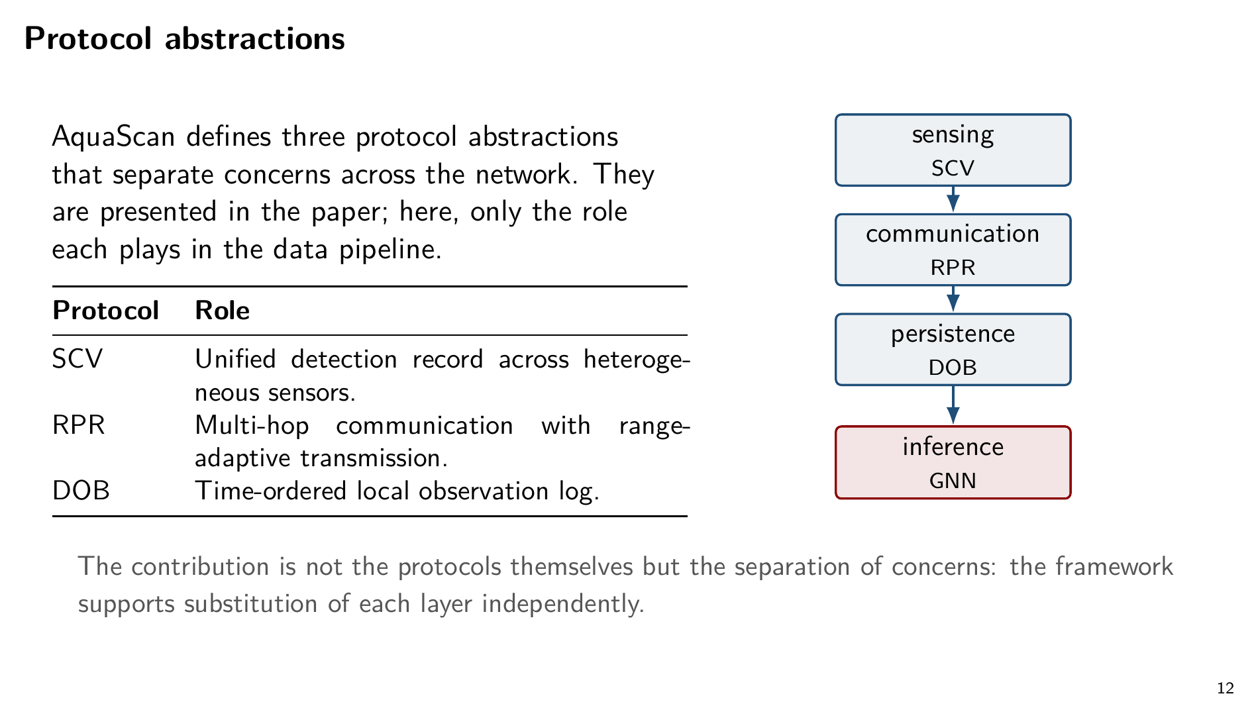
Notes:
AquaScan also defines three protocol abstractions: SCV for unified detection records across heterogeneous sensors, RPR for multi-hop communication with range-adaptive transmission, DOB for time-ordered local observation logs.
The point is the separation of concerns, not the specific protocols. The framework supports substitution at each layer.

Slide 13
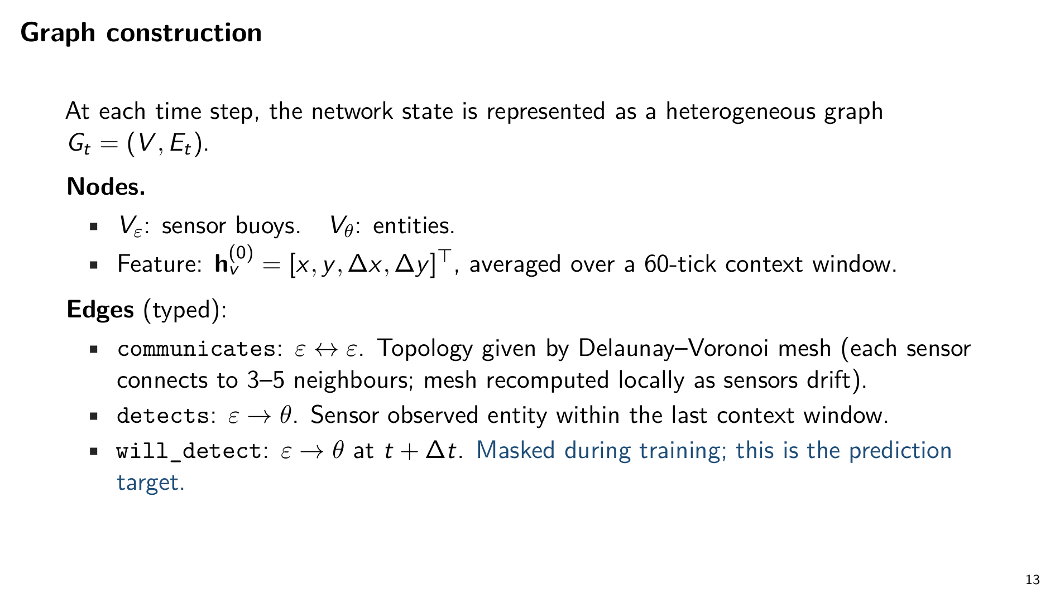
Notes:
From the physical network to something the GNN can learn over.
At each time step we construct a heterogeneous graph. Nodes are the sensor buoys and the entities. Each carries a four-dimensional feature: position and velocity, averaged over a 60-tick window.
Three edge types as on the diagram. The communication edges follow a Delaunay-Voronoi mesh — each sensor wired to its three-to-six closest neighbours, redrawn locally as buoys drift. The will_detect edges are masked during training; predicting them is the entire task.

Slide 14
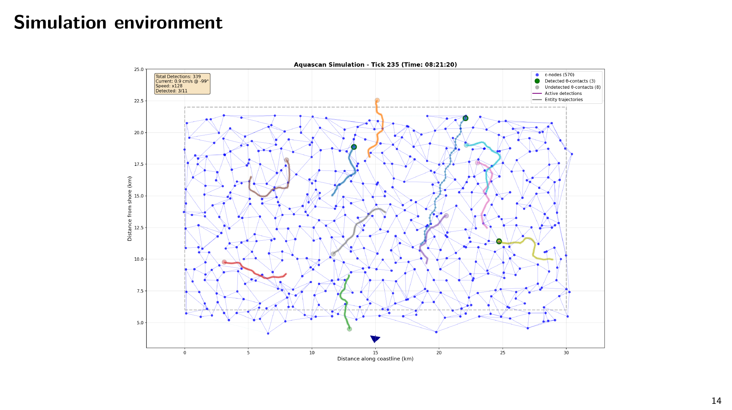
Notes:
What the simulation looks like in motion. This is tick 235, about eight and a half hours in.
570 sensor buoys on a hexagonal grid, deformed by the current field. 15 to 20 entities with coloured tracks — drift-dominated random walks for fish, directed sinusoidal trajectories for cetaceans. The mesh is dynamically re-tessellated as the buoys drift.

Slide 15
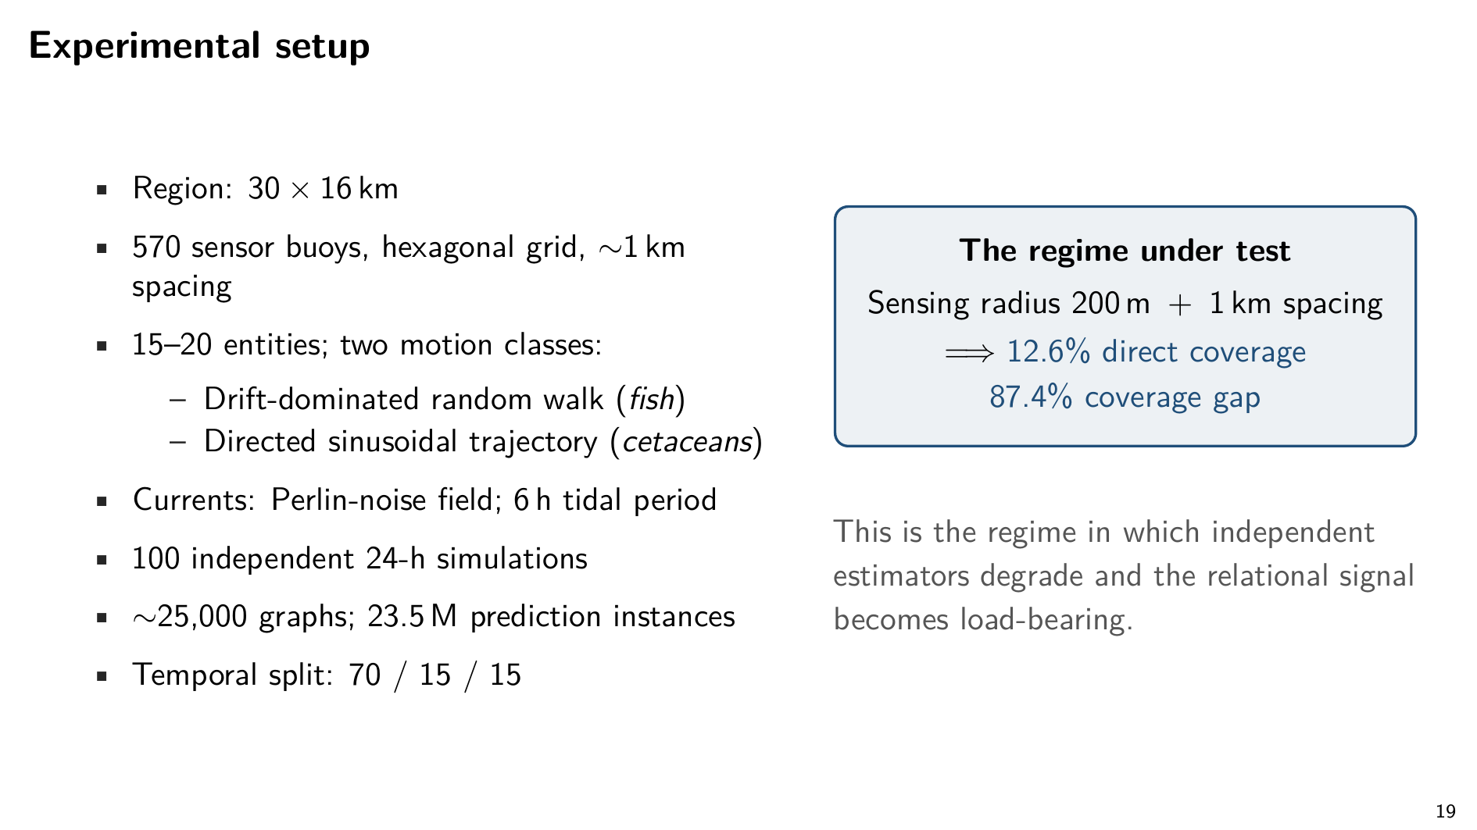
Notes:
Quick numbers on the setup. A 30 by 16 kilometre region. 570 sensor buoys on a roughly hexagonal grid at 1 kilometre spacing. 15 to 20 entities, two motion classes — drift-dominated random walks for fish, directed sinusoidal trajectories for cetaceans. Currents simulated with Perlin noise on a 6-hour tidal period.
The key fact, in the box on the right: 200 metre sensing radius plus 1 kilometre spacing gives roughly 12.6% direct coverage. Almost 90% of the area is a coverage gap. That's the regime where independent estimators degrade and the relational signal becomes load-bearing.
100 independent 24-hour simulations. About 25,000 graphs. 23.5 million prediction instances. Temporal split, 70/15/15.

Slide 16
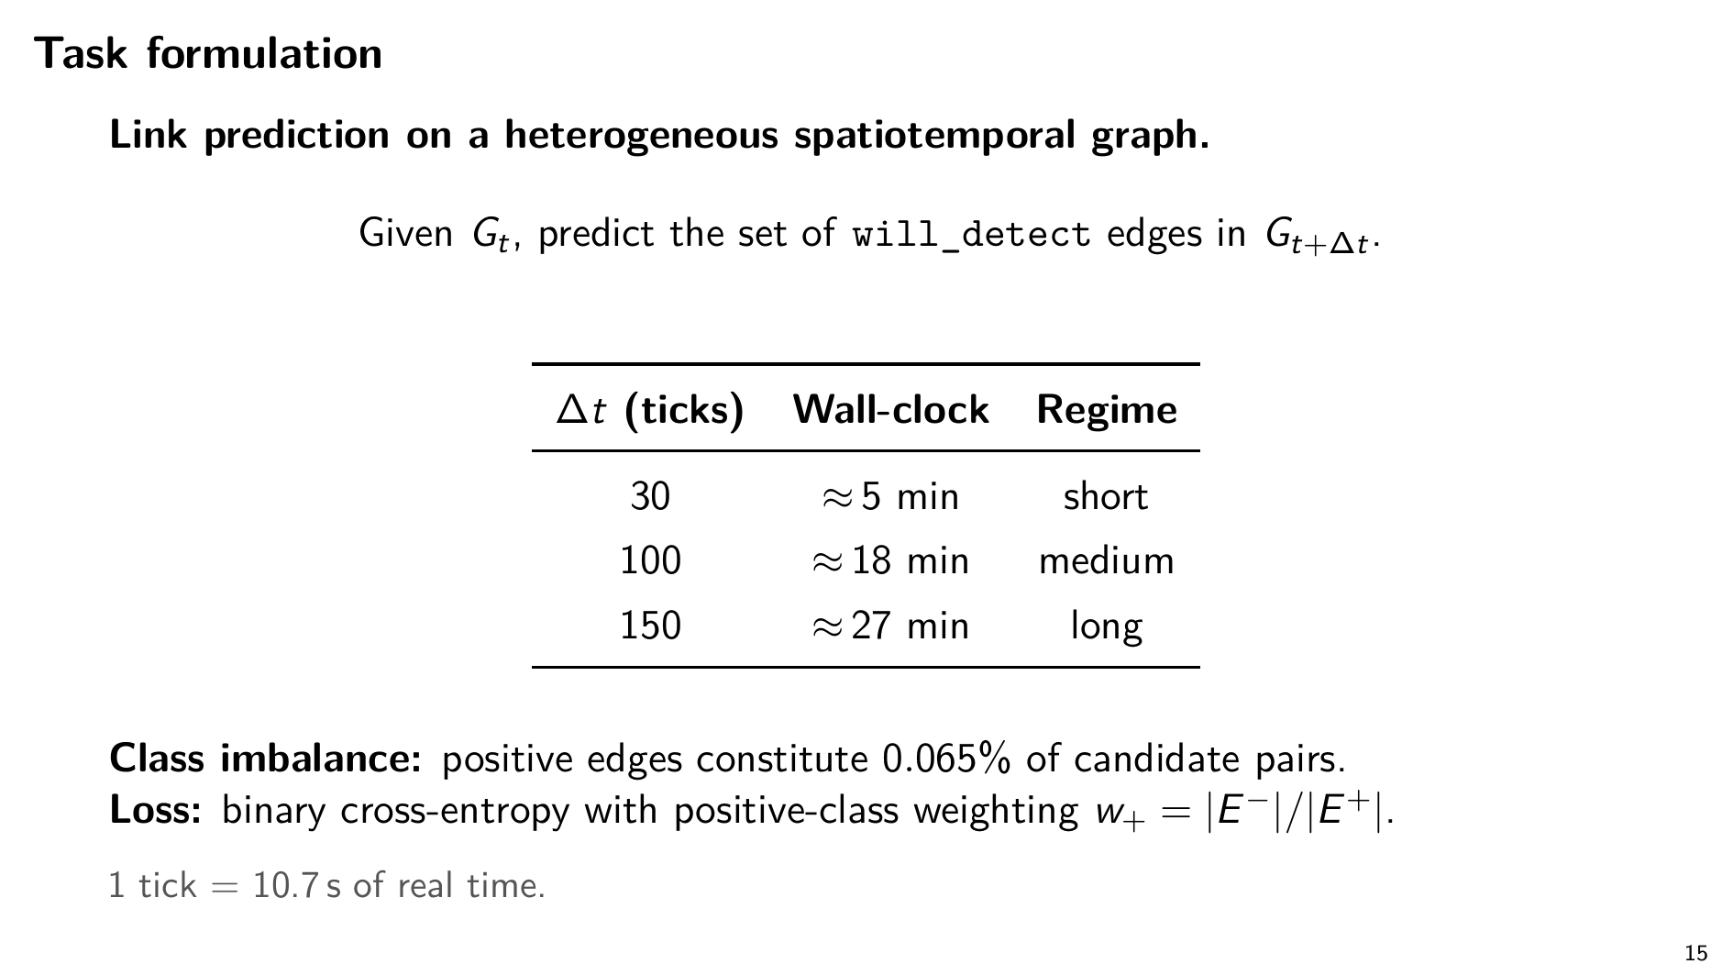
Notes:
So the problem reduces to link prediction on a heterogeneous spatiotemporal graph.
Three horizons: 30, 100, and 150 ticks — roughly 5, 18, and 27 minutes into the future.
One thing to flag: class imbalance is severe. Only 0.065% of candidate edges are positive. We handle it with positive-class weighting in the binary cross-entropy loss.

Slide 17
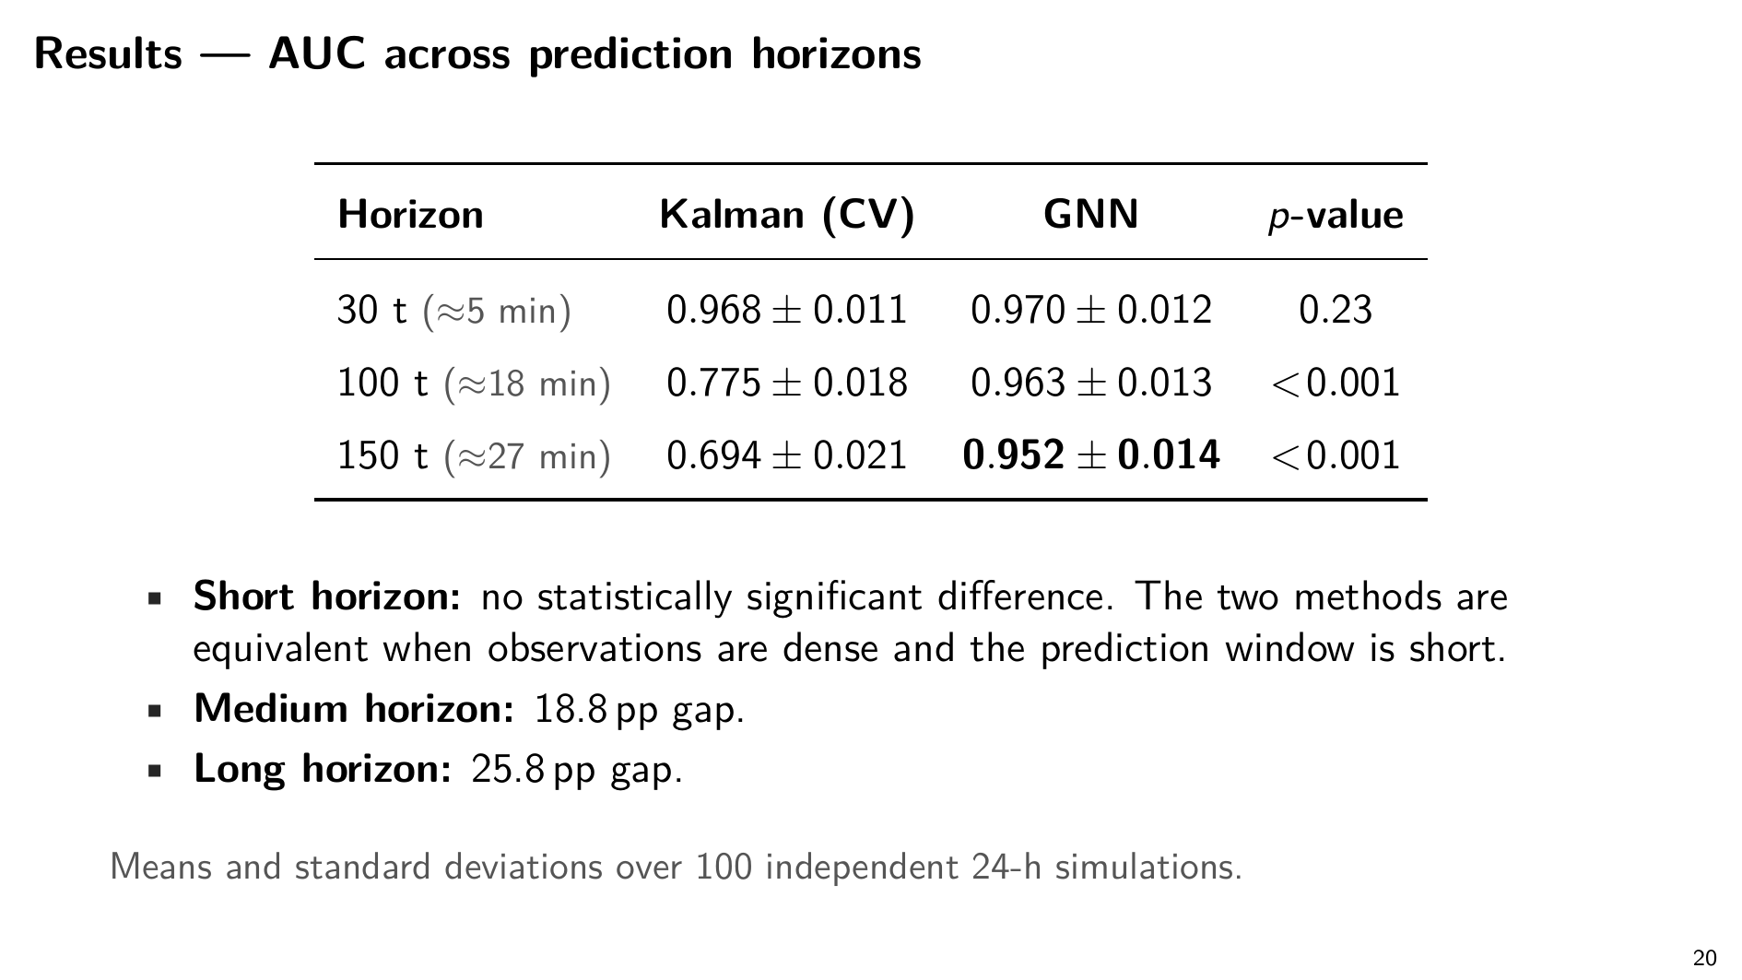
Notes:
The headline numbers.
At 30 ticks — about 5 minutes — the two methods are statistically tied. Kalman 0.968 AUC, GNN 0.970. p equals 0.23. When observations are dense and the future is close, a properly tuned Kalman filter is fine. There's no magic in the GNN at short horizons.
At 100 ticks — 18 minutes — Kalman drops to 0.775. The GNN holds at 0.963. About 19 percentage points.
At 150 ticks — 27 minutes — Kalman degrades to 0.694. The GNN holds at 0.952. Almost 26 percentage points. Both p-values below 0.001.

Slide 18
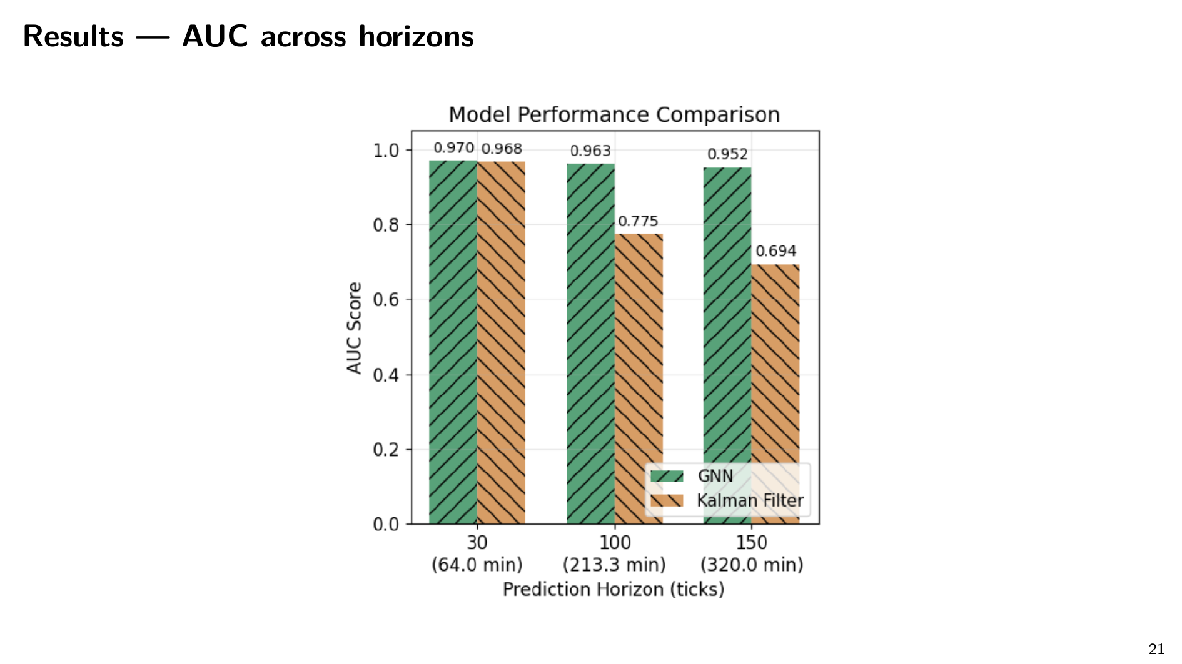
Notes:
Same numbers, plotted with 95% confidence intervals. At 30 ticks the bars overlap. At 100 and 150 they don't — the Kalman bar drops out from under the GNN.

Slide 19
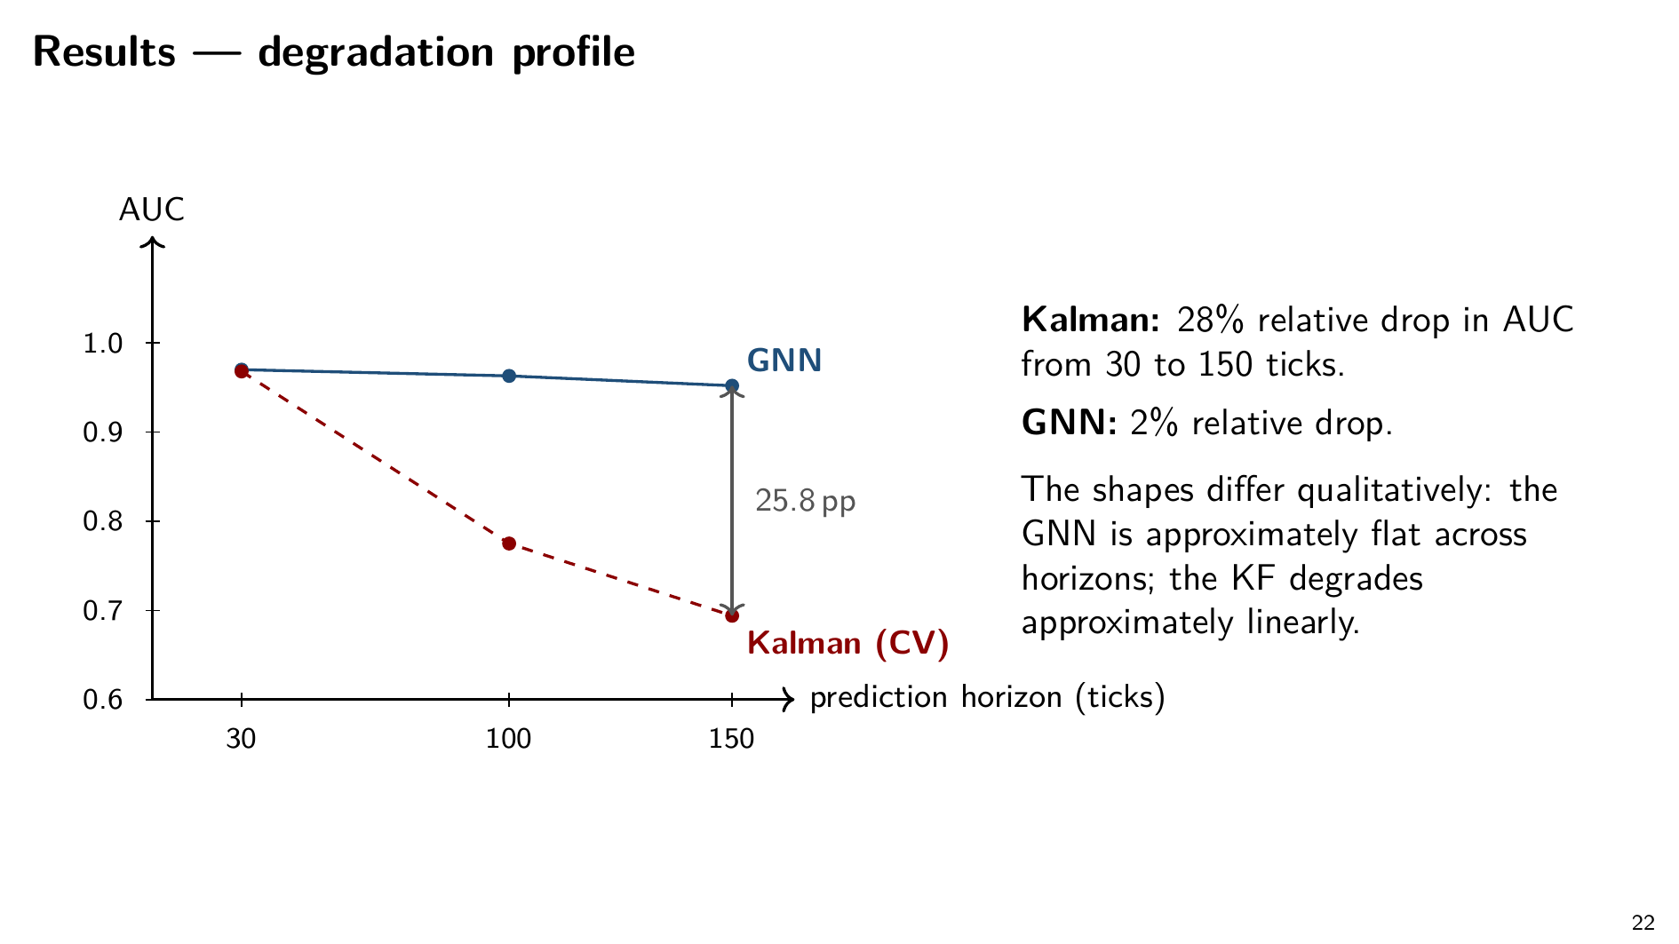
Notes:
Now look at the shape, not just the numbers.
Kalman loses about 28% of its baseline performance from 30 to 150 ticks. The GNN loses about 2%. Essentially flat versus a clean linear decline.
It's not that the GNN is marginally better at every horizon. The two curves diverge.

Slide 20
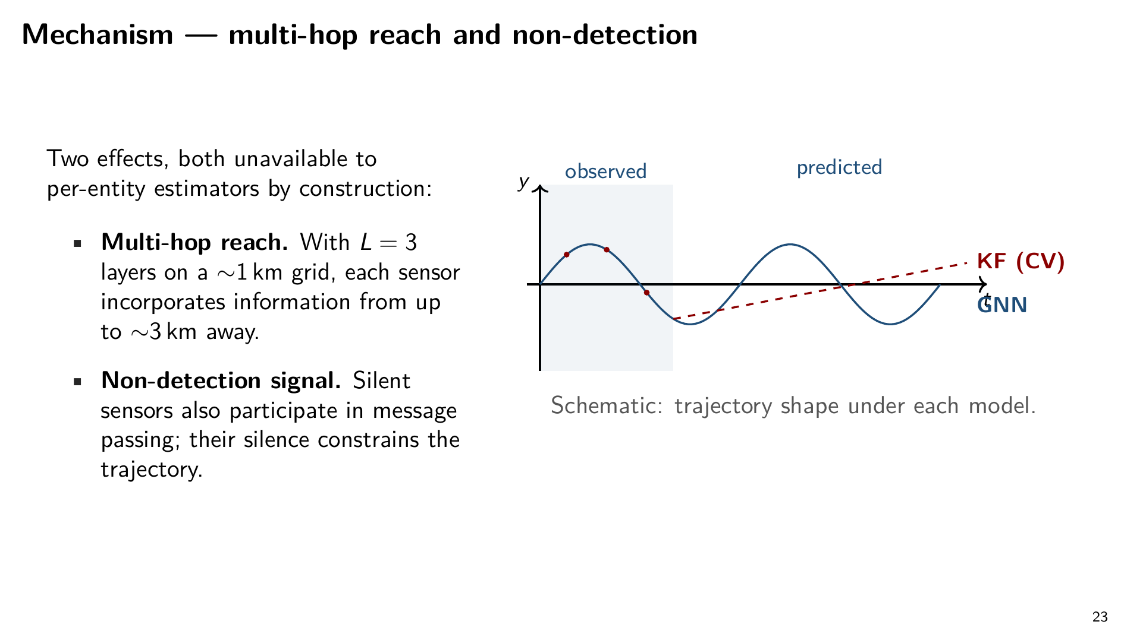
Notes:
What's doing the work? Two mechanisms, both unavailable to per-entity estimators by construction.
First, multi-hop reach. With three layers and a 1 kilometre grid, each sensor's representation incorporates information from up to about 3 kilometres away — enough to capture local current fields and motion regimes.
Second, the non-detection signal. Sensors that did not observe an entity still participate in message passing. Their silence constrains the inferred trajectory. The same point I flagged at the start.
There's a qualitative bonus too. The GNN preserves trajectory shape — sinusoidal motion stays sinusoidal. The constant-velocity Kalman filter, once it loses contact, projects a straight line. That's the motion model talking, not the data.

Slide 21
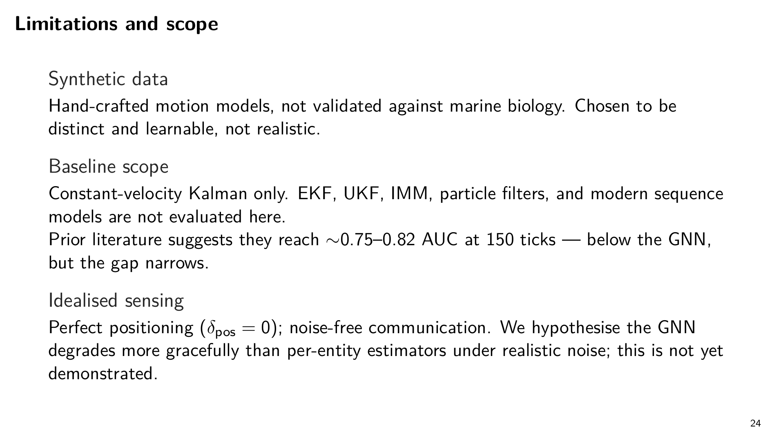
Notes:
Three caveats I want on the table.
Synthetic data. Motion models are chosen to be distinct and learnable, not realistic.
Simplest baseline only. We covered this on the methods slide.
Idealised environment. Perfect positioning, noise-free communication. We hypothesise GNNs handle real-world messiness gracefully. We haven't proven it.

Slide 22
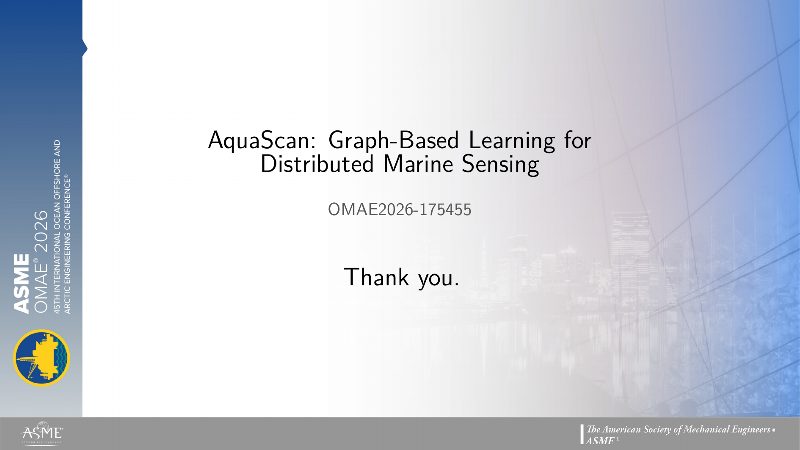
Notes:
So, this is our work, once again thank you for having me and I am available for any questions you might have. Thank you.

Slide 23
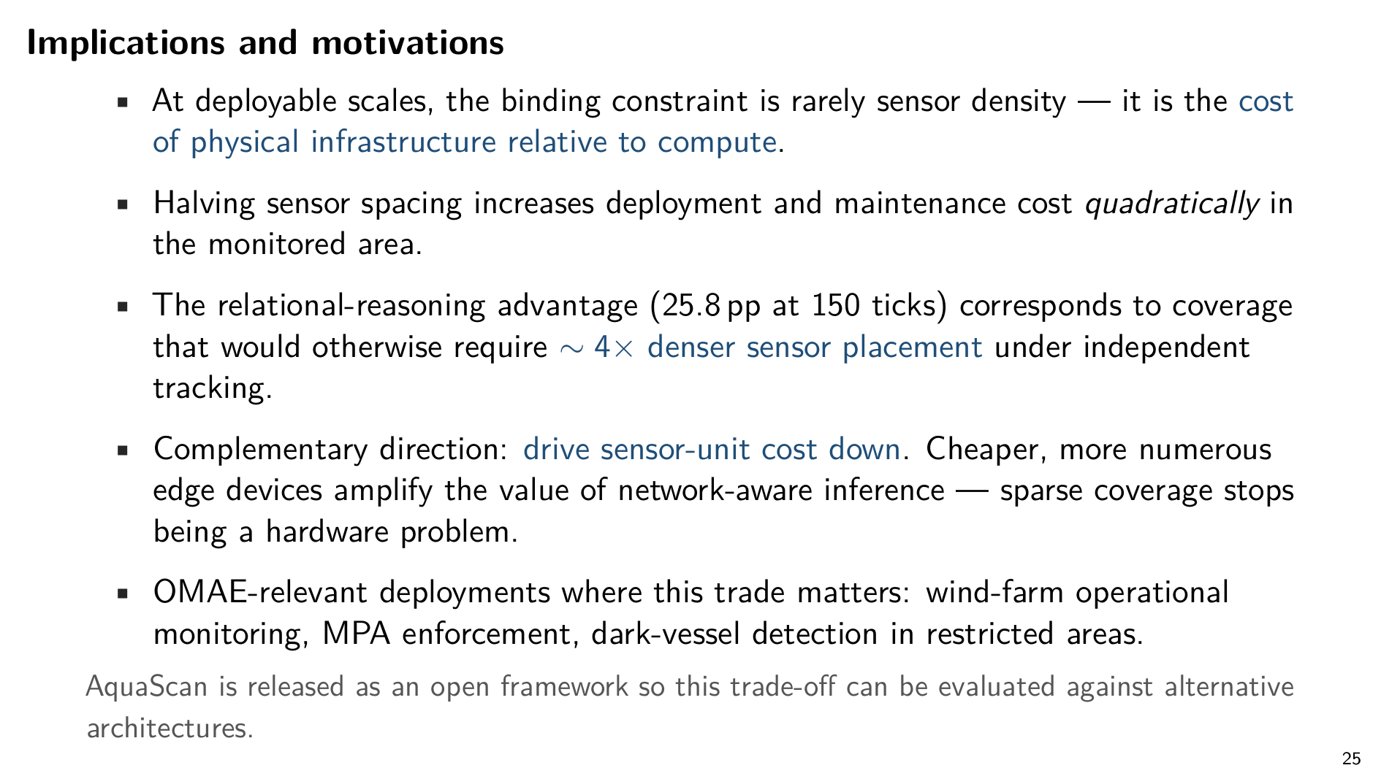
Notes:
The takeaway is operational.
At deployable scales, the binding constraint on a sensor network is rarely sensor density — it's the cost of physical infrastructure relative to compute. Halving sensor spacing increases deployment and maintenance cost quadratically in the monitored area.
Our 26-percentage-point gap at the 27-minute horizon corresponds to coverage that would otherwise require roughly four times denser sensor placement under independent tracking.
There's a complementary direction worth flagging: drive the unit cost of sensors down. Cheaper, more numerous edge devices amplify the value of network-aware inference — sparse coverage stops being a hardware problem.
For OMAE-relevant deployments — wind-farm operational monitoring, marine protected area enforcement, dark-vessel detection in restricted zones — this trade favours sparser hardware and smarter inference.
AquaScan is released as an open framework so this trade-off can be evaluated against alternative architectures.

Slide 24
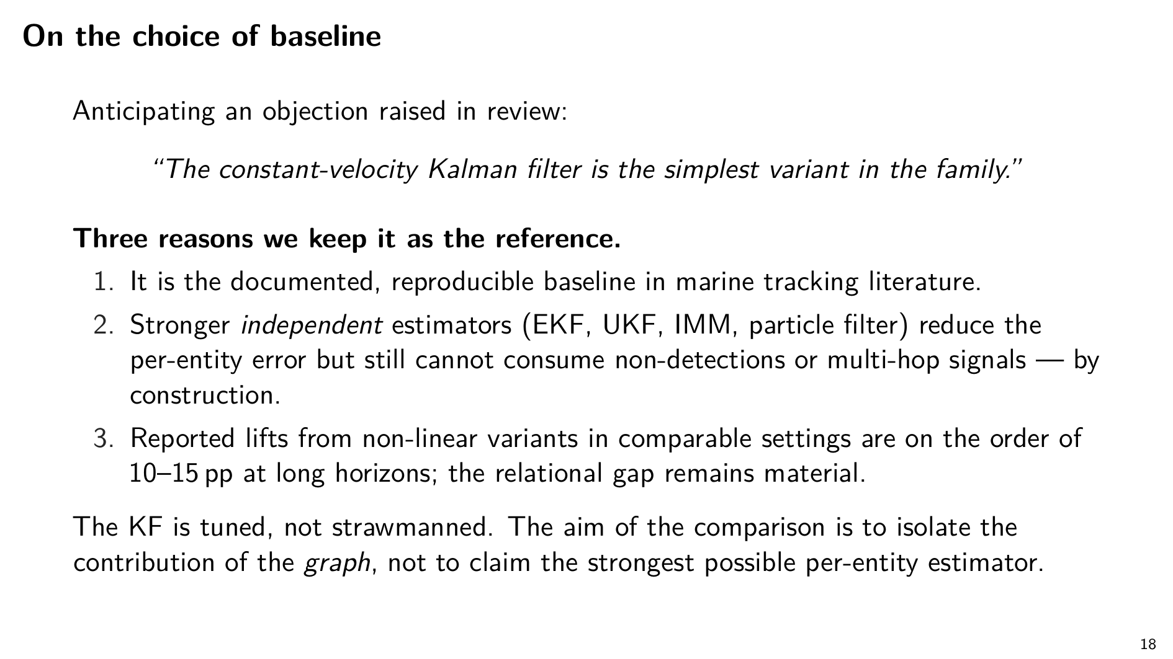
Notes:
A note on the baseline, because this came up in review.
Yes, constant-velocity is the simplest variant in the Kalman family. We kept it deliberately, for three reasons.
First, reproducibility: it's the standard documented baseline in marine tracking literature.
Second, isolation: stronger per-entity estimators still cannot use non-detections or multi-hop signals — by design. Swapping in a stronger per-entity tracker doesn't answer the question we're asking.
Third, the gap. Stronger variants would likely lift the baseline by 10 to 15 percentage points at long horizons. That still leaves a substantial gap, and that gap is the relational portion.
The baseline is tuned, not strawmanned.

Slide 25
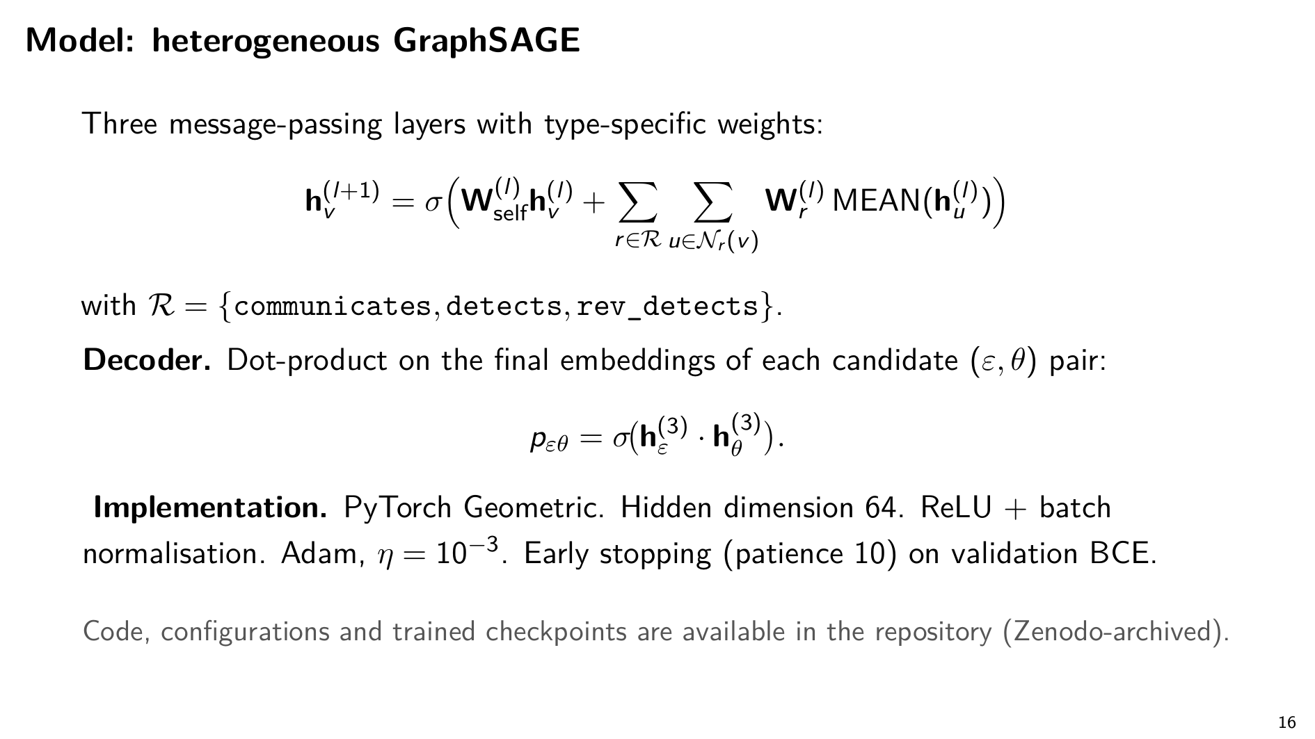
Notes:
Our model is a heterogeneous extension of GraphSAGE. Three convolution layers, 64-dimensional hidden states, edge-type-specific aggregation. The decoder is a dot product on the final node embeddings — we score every sensor-entity pair for the probability that a detection will occur.
Standard Adam, learning rate 1e-3, early stopping on validation BCE. PyTorch Geometric. Code and trained checkpoints are in the Zenodo-archived repository.

Slide 26
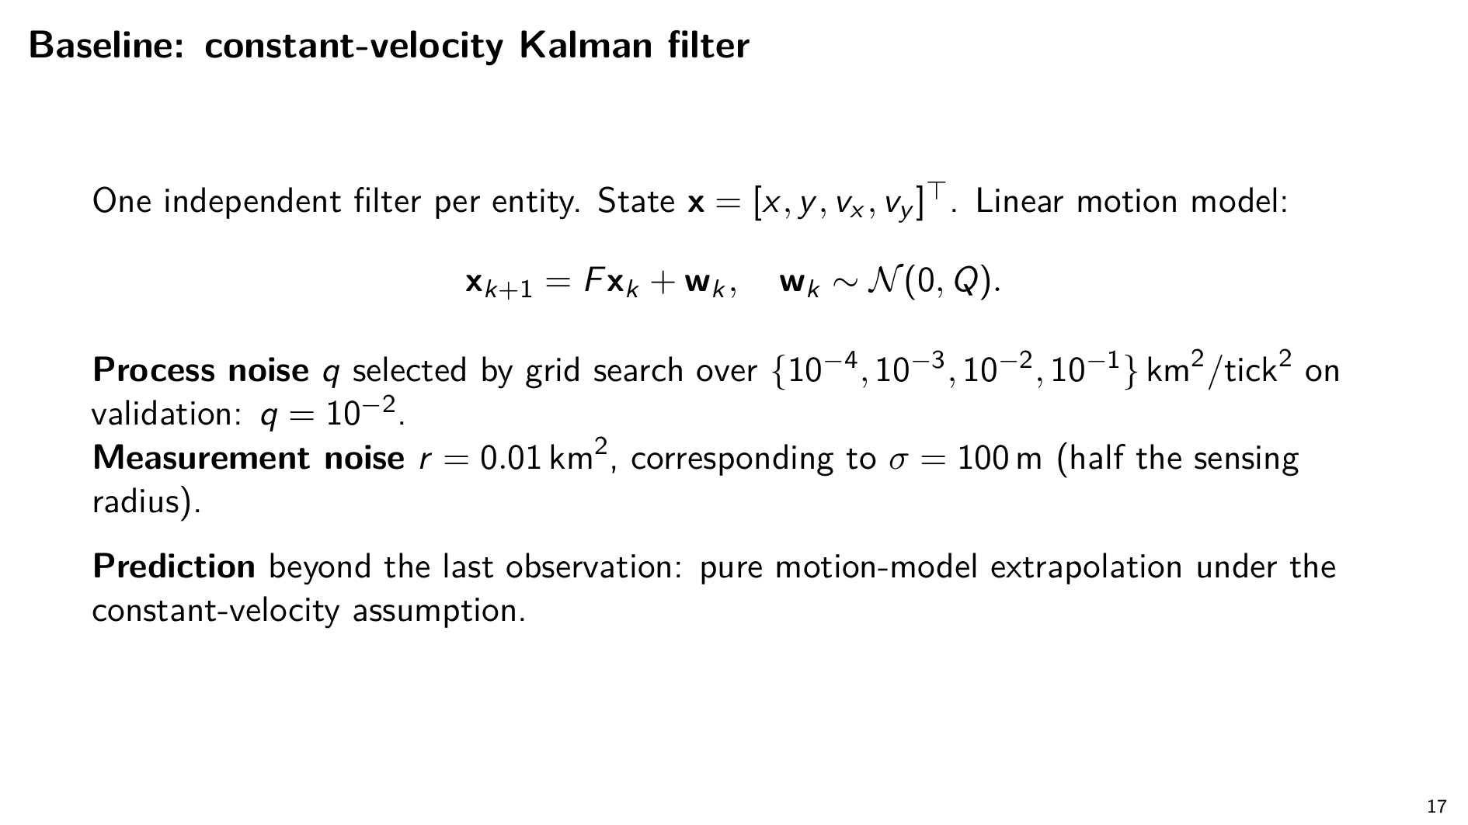
Notes:
The baseline is a constant-velocity Kalman filter, one independent filter per entity. Standard four-dimensional state — position and velocity.
Process noise grid-searched and selected on validation. Measurement noise set to roughly half the sensing radius. Prediction beyond the last observation is pure constant-velocity extrapolation.

Slide 27
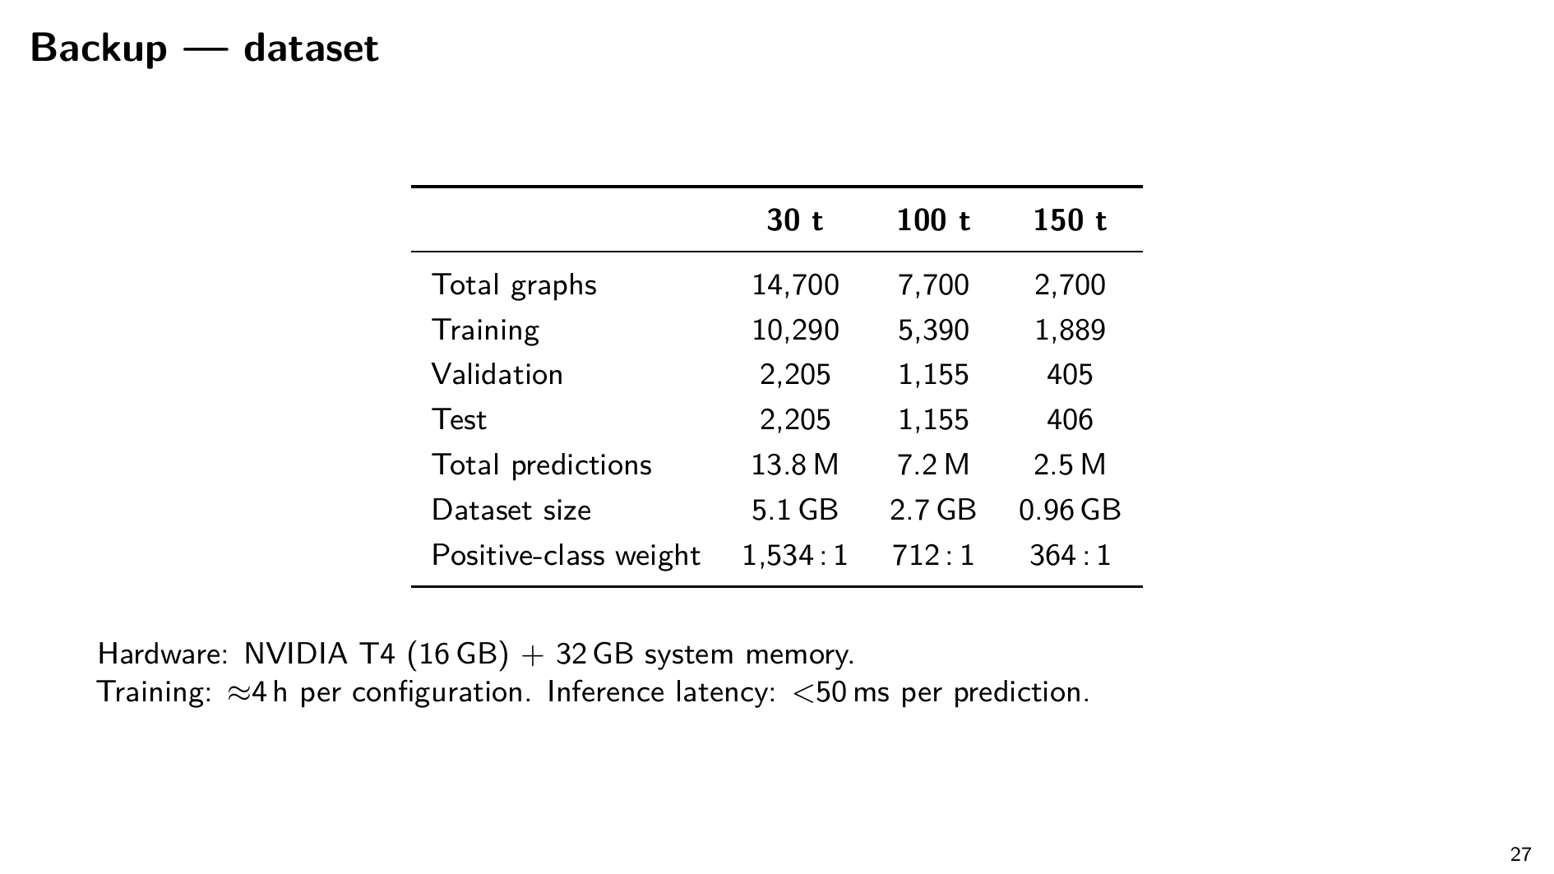
Notes:
Dataset scale: graphs per horizon, training/val/test split, predictions, compute cost. Use if asked about reproducibility or compute budget.

Slide 28
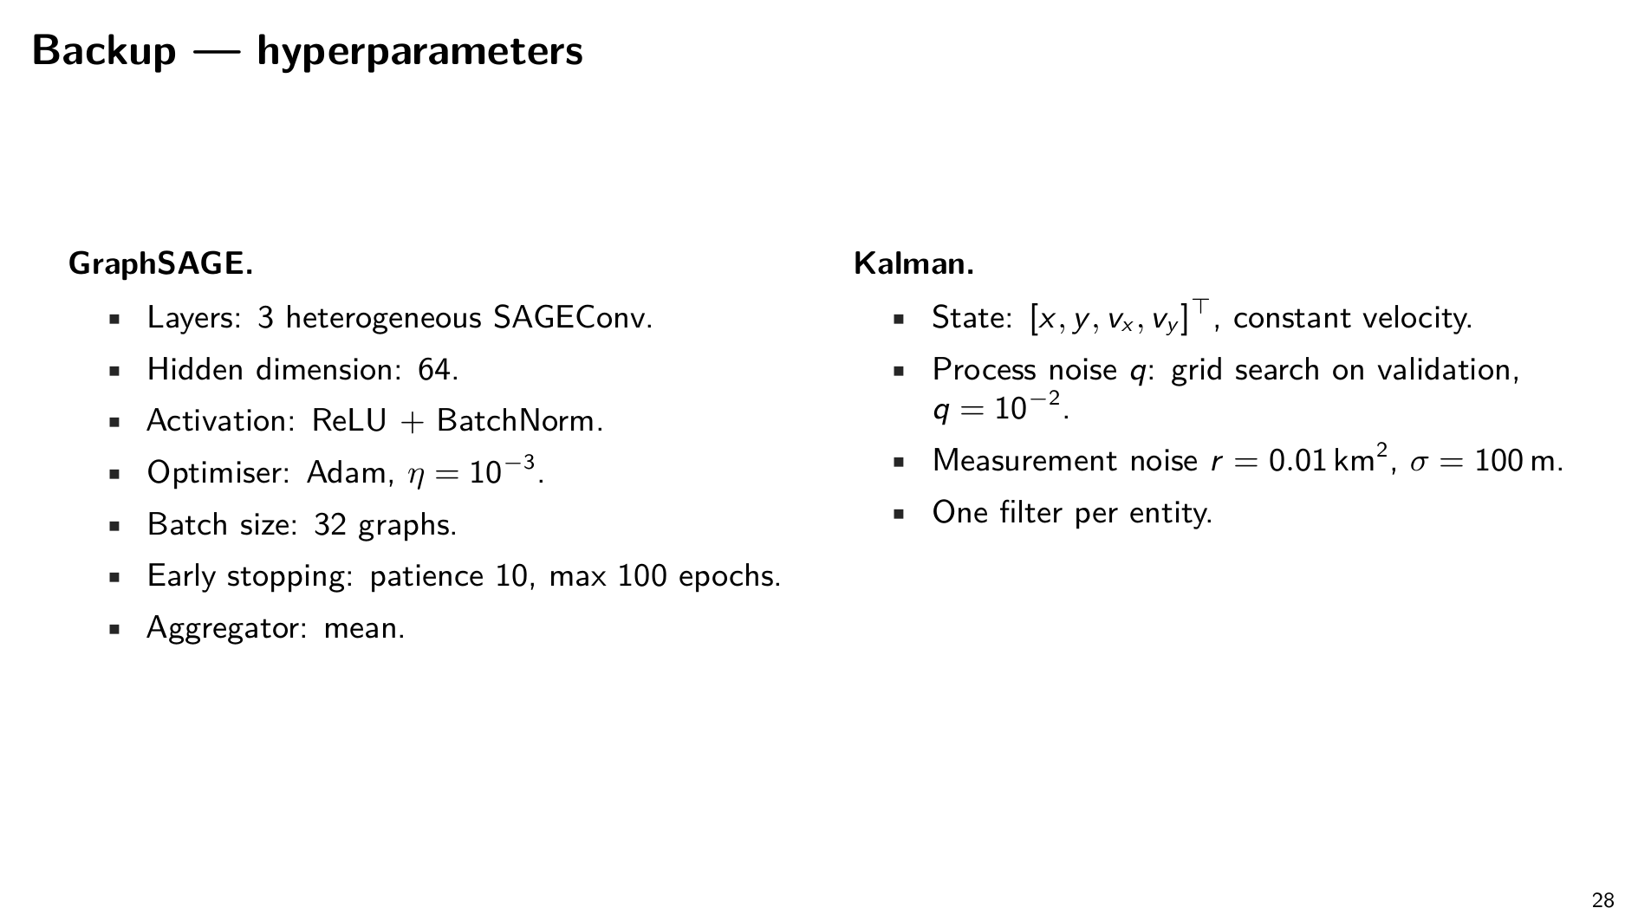
Notes:
Full hyperparameter table for GraphSAGE (3 SAGEConv layers, 64-dim, mean aggregator, Adam 1e-3, batch 32, early stop patience 10) and Kalman (CV state, q=1e-2, r=0.01 km²).

Slide 29
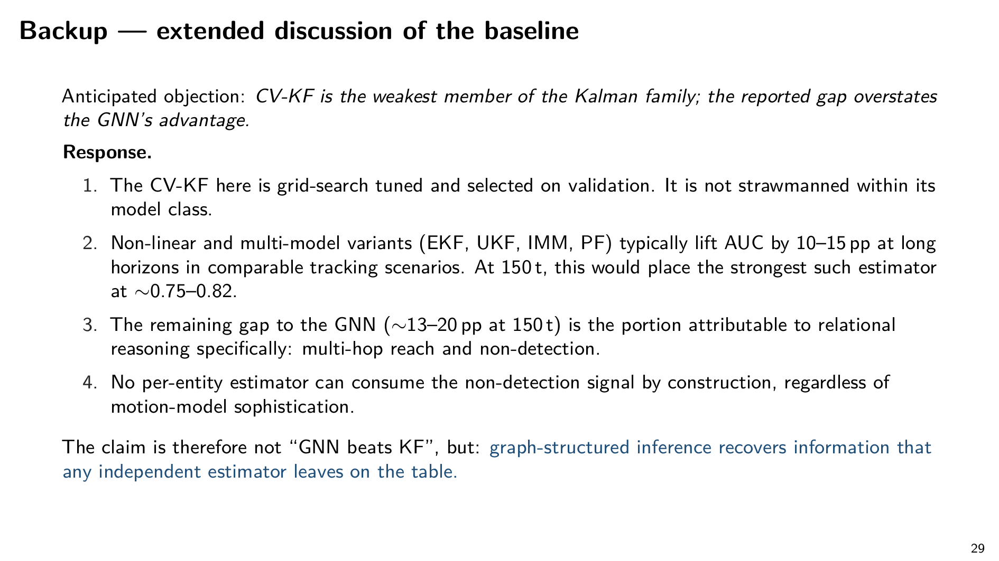
Notes:
Extended baseline defence. Use if pressed on the 'strawman' objection: tuned, isolation of the right variable, 10–15 pp prior-lit lift estimate, irreducibility of non-detection / multi-hop for any per-entity tracker.

Slide 30
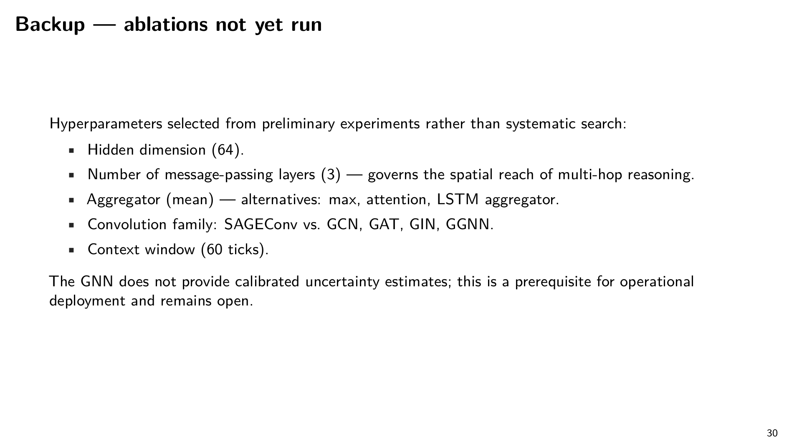
Notes:
Ablations we did not run: depth, hidden width, aggregator, alternative convolutions (GCN/GAT/GIN/GGNN), context window. No uncertainty quantification yet.

Slide 31
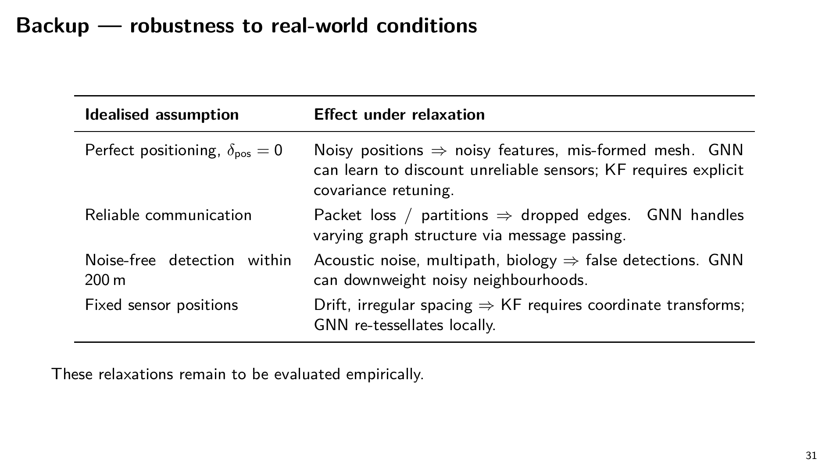
Notes:
Real-world relaxations: noisy positions, packet loss, acoustic noise, drifting sensors. Hypothesised GNN advantage under each; not empirically validated.

Slide 32
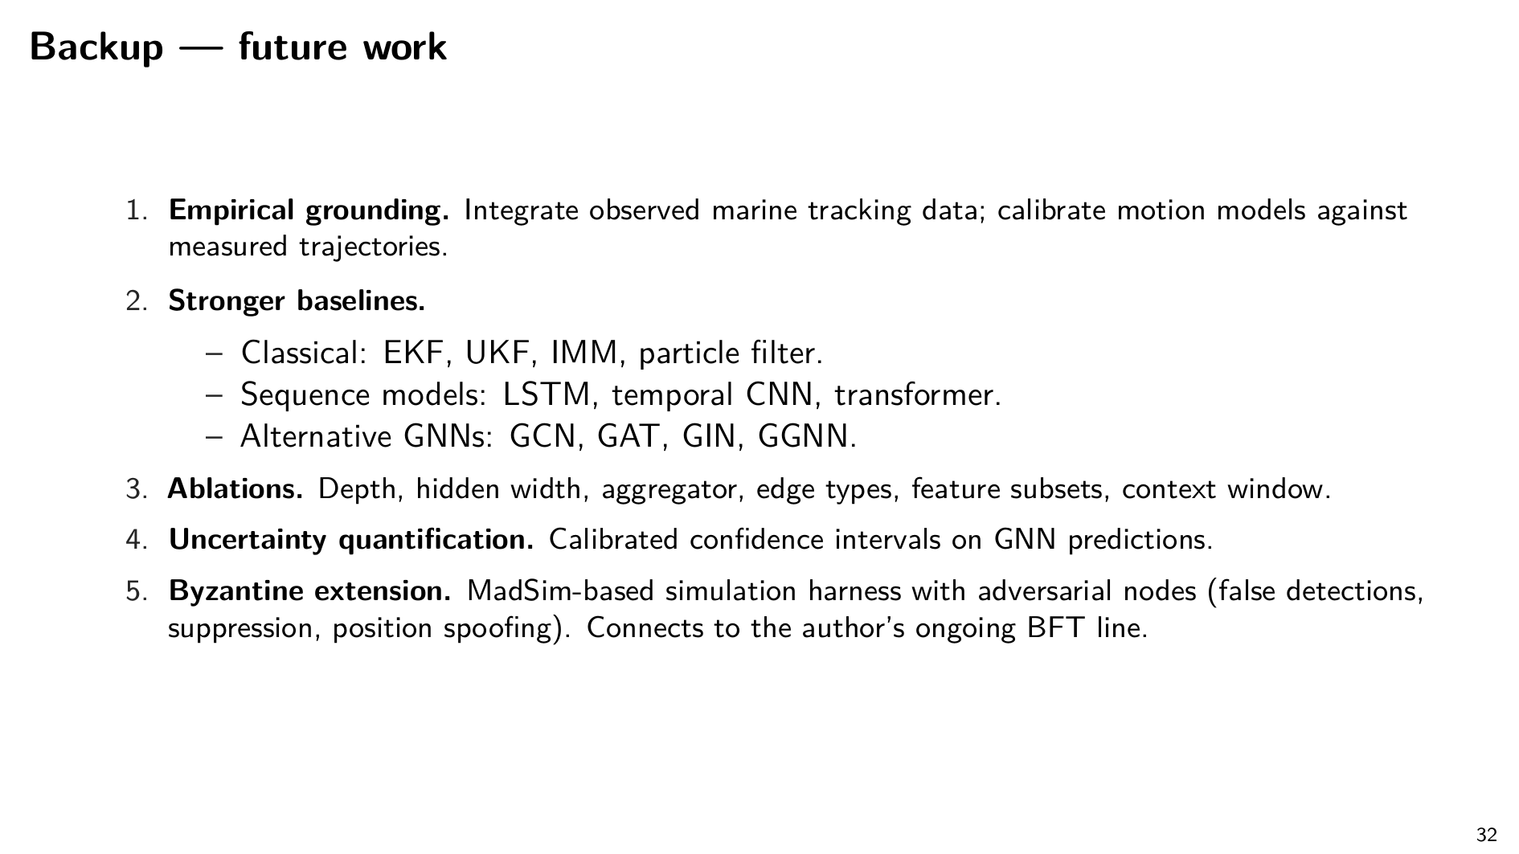
Notes:
Future work, including the Byzantine extension via MadSim (false detections, suppression, position spoofing). This is the bridge to the BFT line I opened the talk on.

Slide 33
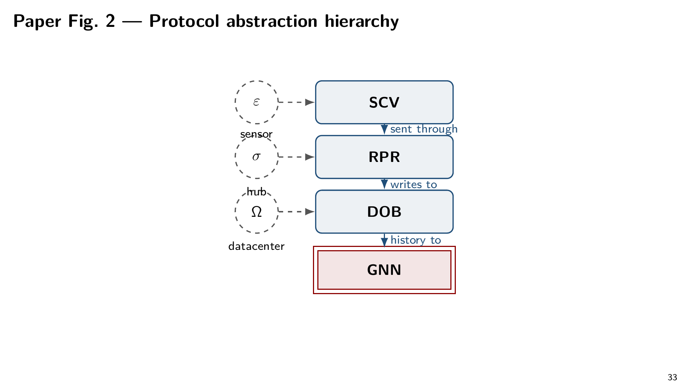
Notes:
Paper Fig. 2 — protocol stack (SCV → RPR → DOB → GNN). Use if asked how data flows through the architecture.

Slide 34
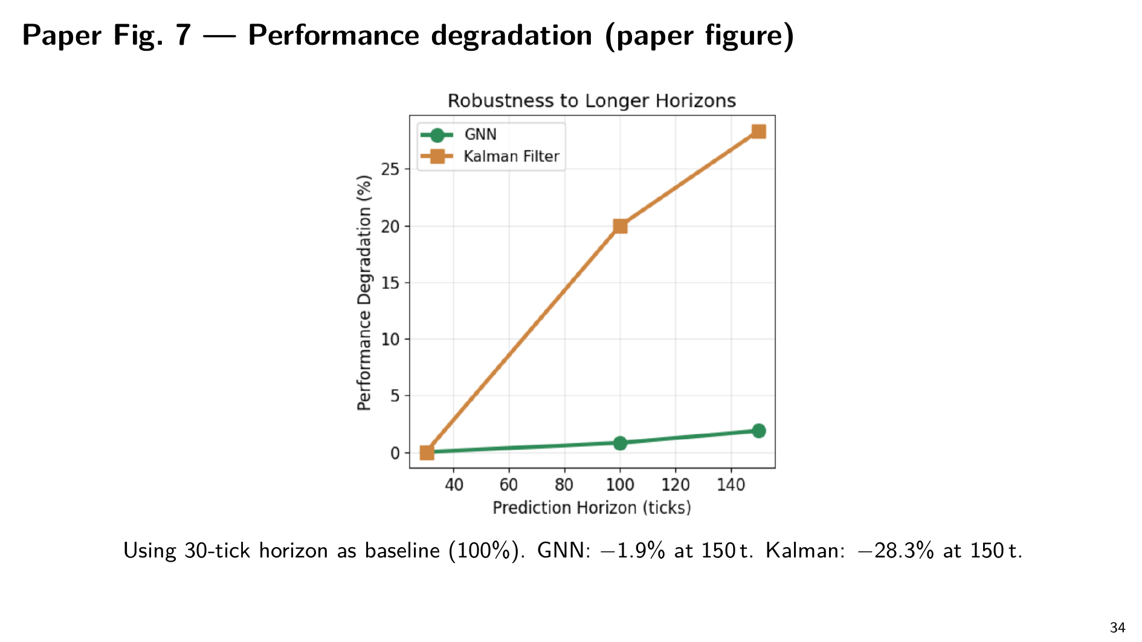
Notes:
Paper Fig. 7 — degradation chart from the paper itself. Same story, original plot.

Slide 35
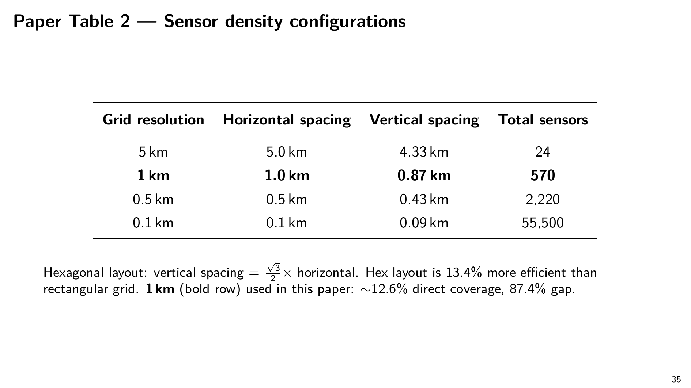
Notes:
Paper Table 2 — sensor density configurations. Use if asked about scaling sensor density up or down.

Slide 36
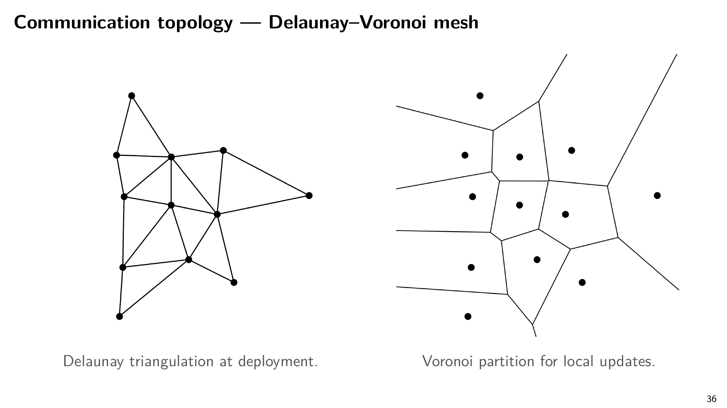
Notes:
Communication topology — Delaunay-Voronoi mesh. Use if asked how the sensors are wired together, how the mesh handles drift, or about transmission-power efficiency. Local re-tessellation is O(k); Delaunay minimises longest edge.

